Slide 1
Language Centre
Information to Exchange students
Åbo, January 2025

Slide 2
The Language Centre in a nutshell
Operates in Åbo and Vasa
Courses in languages and communication, for example:
Swedish and Finnish as a Foreign Language (max. 24 students/group)
Other foreign languages (taught in Swedish)
Language response of degree theses
Text consultation
Language proficiency tests

Slide 3
Language courses: Swedish
We offer Swedish as a foreign language, levels 1-4.
Note! If you have previous knowledge of Swedish and need to be tested, please contact the teacher: Charlotta.Sandberg@abo.fi

Slide 4
Swedish as a foreign language, level 1, 5 ECTS
Level A1 (CEFR)
The course gives the students a basic knowledge of the Swedish language.
Students are familiarized with the Swedish language and learn something about everyday life in both Finland and Sweden.
Participants learn the basics of grammar (nouns, conjugations of adjectives, verb tenses, pronouns, numerals, and word order).
Teacher: Charlotta Sandberg, Jane Wingren
Languages of instruction: Swedish and English
2 groups in the spring
Registration by 8 January in Peppi.

Slide 5
Swedish as a foreign language, level 2, 5 ECTS
Level A1-A2 (CEFR)
The students will obtain a functional everyday working vocabulary.
Grammar points are extended to include paste tense, perfect tense, comparative adjectives, and subordinate clauses.
Teacher: Charlotta Sandberg
Languages of instruction: Swedish and English
1 group in the spring
Registration by 8 January in Peppi.

Slide 6
Swedish as a foreign language, level 4, 5 ECTS
Level B1-B2 (CEFR)
In this level we learn vocabulary that covers the majors of the students in the group. We also read newspaper articles etc.
The basic grammatical structures will have been covered in the previous courses, but word formation, prepositions of time as well as phrasal verbs will be topicalised.
Teacher: Charlotta Sandberg
Languages of instruction: Swedish
1 group in the spring
Registration by 8 January in Peppi.

Slide 7
Language courses: Finnish
We offer Finnish as a foreign language, levels 1-4.
Levels 1 and 2 are already full.

Slide 8
Finnish as a foreign language, level 1, 5 ECTS
Level A1 (CEFR)
The course gives the students a basic knowledge of the Finnish language and everyday life in Finland.
Participants learn the basics of grammar (nouns, conjugations of adjectives, verb present tenses, pronouns and numerals).
Teacher: Nina Shpakouskaya
Languages of instruction: Finnish and English
2 groups in the spring
Registration by 5 January in Peppi.

Slide 9
Finnish as a foreign language, level 2, 5 ECTS
Level A1-A2 (CEFR)
Participants learn to understand Finnish in various everyday situations, and they will be able to take part in short informal discussions. They will obtain a functional everyday vocabulary.
Grammar points are extended to include, for instance, partitive plural, the object, necessive clauses and infinitives.
Teacher: Mariia Vasara
Languages of instruction: Finnish and English
1 group in the spring
Registration by 5 January in Peppi.

Slide 10
Finnish as a foreign language, level 4, 5 ECTS
Level B1-B2 (CEFR)
The course is designed to help students achieve a proficiency that enables them to interact professionally within their own subject field. All teaching takes place in Finnish.
The course material consists of authentic texts from newspapers, journals and other media elements.
Teacher: Mariia Vasara
Languages of instruction: Finnish and English
1 group in the spring
Registration by 5 January in Peppi.

Slide 11
Other languages offered
English
French
German
Italian
Latin
Russian
Spanish
Swedish-Finnish sign language
Good knowledge of Swedish is required!

Slide 12
eTandem for Foreign Languages Level A2, 5 ECTS (Spring 2025)
Course aims:
To give the student the opportunity to become familiar with the target language and the culture where it is spoken
improve his or her communication skills in the target language
teach the tandem partner his or her own language and culture
promote the contact between students with another mother tongue
prepare for exchange studies abroad
help students from abroad to adjust to life in Finland
Teacher: Loukia Lindholm
Enroll by filling out the form (registration by 17 January 2025).
First meeting/kickoff Friday, January 31, 2025, 12-13, Arken, Atlas, G105

Slide 13
Language Café - Språkkafé
The popular language cafés for international students continue with new meetings during the spring semester.
Gatherings with various themes and activities are scheduled from January to May.
The language cafés offer international students the opportunity to practice spoken Swedish and Finnish in pleasant, relaxed and authentic situations, guided by ÅA students who serve as tutors during the sessions.
For more information about the language cafés,
please contact the coordinator,
Marit Vest-Sjöholm (marit.vest-sjoholm@abo.fi).

Slide 14
Writing retreat
Take a leap towards finishing your thesis at our writing retreat!
We will spend five days writing in a supportive and motivating environment on campus. Language support will be available at all times, and you will also have the opportunity to discuss your writing individually with an English teacher.
When: Spring 2025 Where: on Campus Who: ÅAU students working on a longer text, such as a thesis. Participation is free of charge.
If you have any questions, please contact Loukia.Lindholm@abo.fi

Slide 15
Important!
Register for the course version you wish to attend via Peppi.
Be present at the start of the first session, regardless of whether it is a physical or virtual session.
Updated information about our courses can be found in the Study Guide.
If you have any questions, please contact sprakcentret-abokansli@abo.fi or our teachers.

Slide 16
Check your CEFR-level here
Not sure which CEFR-level is suitable for you?

Slide 17
Communication channels
Study Guide
Language Centre webpages on the intranet
Instagram
Newsletter
Remember to read your abo.fi e-mail regularly!

Slide 18
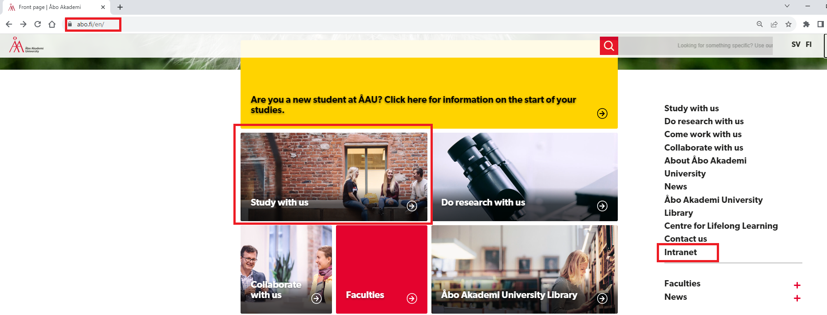
Website abo.fi/en

Slide 19
Intranet

Slide 20
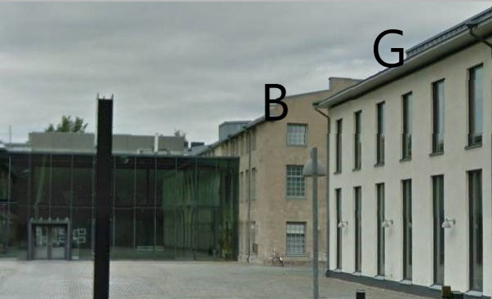
Location in Åbo/Turku
Fabriksgatan 2, Arken
Building B, 2nd and 3rd floors
Building G, 1st and 2nd floors

Slide 21
Guidance and counselling
Administrative Director
Mia Panisse
Office: Arken, G 104
mia.panisse@abo.fi, sprakcentret-utbildningschef@abo.fi
Tel. +358 2 215 4593
Study Advisor
Hanna Engblom
Office: Arken, B 202
Tel. +358 2 215 4365
hanna.engblom@abo.fi, sprakcentret-abokansli@abo.fi

Slide 22
Welcome to the Language Centre!

