Slide 1
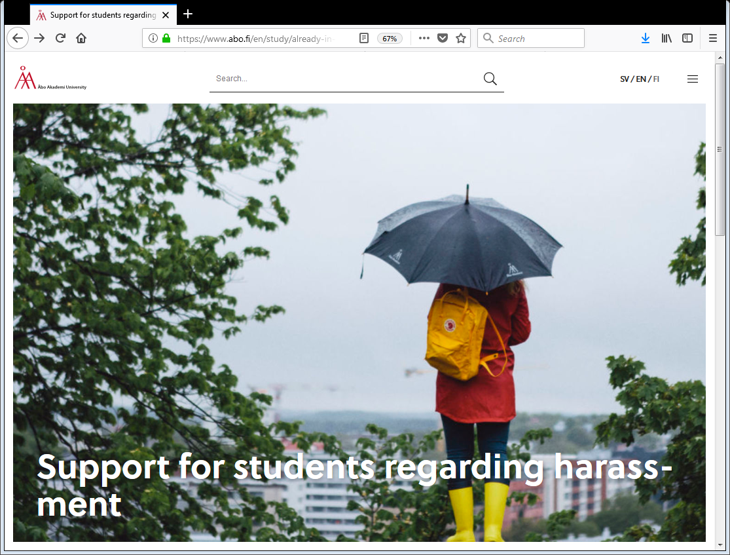
Safe Space
Jan Kraufvelin
Contact person in case of harassment
Åbo Akademi University

Slide 2
Introduction - One community & one ÅAU where everyone are safe, heard and supported
Aim & Purpose
Help you be aware and recognize harassment, discrimination and violence when you witness or experience it.
Prevent instances of harassment, discrimination and violence related to students.
Empower students to react and speak up in situations of harassment, discrimination and violence, and know who to contact.
Create an atmosphere of respect and understanding that different peoples’ experiences of harassments & discrimination can differ.
Session’s topics
Harassments & Discrimination definitions
Examples of Harassments & Discrimination
What to do & who can help
Who's concern?
Notes:
As students, as members of ÅA we need to work and act as a community to create a space where everyone is safe and supported. We live in a world with a lot of exclusion, hate, discrimination and this session is a small part in trying to create those spaces by openly addressing the issues, the faults and our responsibilities. But we hope that creating safe spaces is part of all your time here and after in Orientation week & whole exchange, at ÅA, Finland and as a way to make a safer world.

Slide 3
Harassments & Discrimination definitions in Finnish law
Law on Discrimination
8.1 No one may be discriminated against on the basis of age, origin, nationality, language, religion, belief, opinion, political activity, trade union activity, family relationships, state of health, disability, sexual orientation or other personal characteristics. Discrimination is prohibited, regardless of whether it is based on a fact or assumption concerning the person him/herself or another.
Law on Harassment
14.1 The deliberate or de facto infringement of the dignity of a person is harassment, if the infringing behavior relates to a reason referred to in section 8(1), and as a result of the reason, a degrading or humiliating, intimidating, hostile or offensive environment towards the person is created by the behavior.
Non-discrimination Act https://www.finlex.fi/en/laki/kaannokset/2014/20141325
Notes:
To make sure we all have the same basic understanding we will in the next couple of slides talk about what harassment and discrimination means. This is the Finnish law and Åas policy on the topic.
- age, origin, nationality, language, religion, belief, opinion, political activity, trade union activity, family relationships, state of health, disability, sexual orientation or other personal characteristics

Slide 4
Definition at ÅAU
Åbo Akademi University does not accept any kind of harassment, discrimination or bullying within the university (or in situations related to the university like evening events, parties etc.) among anyone (students, staff, visitors, etc.) and strive to make the university environment a safe space for all.
Harassment violates the individual’s right to personal freedom and integrity, as well as creates a threatening, violent, humiliating or aggressive atmosphere.
Harassment can be defined as unwelcome, unwanted and one-sided physical or verbal behavior towards someone for whom the impact always is negative. What is viewed as harassment, depends on the own perception of the one who is subjected to unwanted behavior.

Slide 5
Examples of direct harassments
Harassments can be expressed in the following ways (but not only)
Physical abuse
Rape or attempted rape
Unwanted physical contact
Demands for sexual intercourse or other kinds of sexual activity
Sexually or racially etc. suggestive gestures or expressions
Indecent talk, suggestive jokes, and unwelcome comments or questions concerning the body, race, gender, clothing or private life etc.
Biased or inappropriate materials, messages or phone calls
Notes:
Direct: one on one interactions, not through a third party. Context, intent and who are bystander. It is often about the individual and their experience. Keep this is mind.
Harassment that is direct may be verbal or physical in nature and happens directed to a person. It can involve someone being the topic of a lewd joke, comments of hurtful/insulting comments to your face, or in worst cases, can involve physical harm, such as inappropriate touching or rape.

Slide 6
Examples of Indirect Harassment
Hearing a comment not explicitly directed to you ex. racist or sexist jokes
Saying bad things about someone in the room but in another language so it may not be directed at them but to degrade them
Being part of the harassment or supporting it, but not being the main offender. Ex. letting friends' cat-call women on the streets or tell inappropriate jokes that you laugh along with
Being silent when knowing about harassment
Notes:
Indirect harassment in opposite to direct is often in relation to a secondary victim who was not the focus of the harassment but was offended by the event, words, pictures or jokes. For example a student can hear a racial comment that is said or joked about in a student café. It was not directed at them but they felt indirectly harassed and often their sense of safety is diminished.
Ableism: discrimination against someone's ability to participate/ people with disability being excluded or targeted.
It may also be someone who is witness to harassment of another person that raises their own worry for their safety depending on their own identities.

Slide 7
Harassment & discrimination – a personal experience
Microaggressions refers to direct or indirect daily comments or behaviour towards a person, often from a marginalized group such as an ethnic minority or people with disabilities etc. The one acting this out may not even do it with the purpose of degrading someone yet still provoking this unintentionally.
Which means: Think first! Perhaps the person you direct your jokes, questions or comments at hears it every day and is tired of hearing it?
“You have so exotic hair!”
“You people …”
“You're transgender? Wow, you don't look like it at all!”
“That’s so gay.”
“No, where are you from originally?”
Microaggressions as annoying as mosquitos

Slide 8
What to do if you are witnessing harassments or discrimination?
Assess the situation, assess your own safety and think about the best action to take.
If possible, try to stop the events unfolding.
Think of context, who can help, severity of the harassments, do you know who oversees the event/happening etc.

Slide 9
What to do if someone tells you they are being harassed or discriminated
Listen & express empathy!
Do not question the story of the person who is telling it to you.
It is not up to you to judge whether what they have experienced is valid.
Direct them or go with them to the relevant points of contact.
Respect their decisions on what to do.
Confidentiality. Being harassed is a very personal experience so respect the persons whishes regarding confidentiality.
Take care of yourself. Being a support to someone or hearing their experience can be hard so also make sure you find a suitable person who can support you if needed.
Notes:
Think of contexts. Acting in parks, clubs, in friendship groups at classes etc. Something it is as easy to interrupt a scenario.
As examples being in a pub and seeing a person being uncomfortable by a stranger. One can pretend to be the persons being harassed friend, it does not have to be a confrontation with the harasser. Think of safety of people around you.
If in a park at night, safe can be to hide and call the police. It is ok to be scared, harassment and discrimination is scary things. But make sure you do something!
Orientation week, make sure you think of other and not apply group pressure which could be harassment to someone. Think inclusive and that the goal is to have fun not degrade people.

Slide 10
What to do & who can help
If you are being harassed or discriminated:
Harassments & discrimination can be confusing, but if you are feeling that something – anything – that happened made you feel uncomfortable or uneasy trust your instincts and go and talk to someone. Could be a friend, staff at the ÅAU & Student Union (in particular the contact persons in cases of harassment), other (support) organisations and/or the police.
Notes:
In the moment of harassment it is hard to tell what to do. Confront or walk away.
Talk to someone. It can be a friend, a teacher or the harassment officers at Kåren & ÅA.
Think of the options of contacting the police´& psychosocial support.

Slide 11
Who's concern & responsibility?
Everyone's
Notes:
Harassment can happen to everyone and it concerns all no matter of gender identities, sexualities, race, ethnicities, abilities, age, religions etc. If someone tells you they are being harassed Believe them, or, at least, do not question the story of the person who is telling it to you. It is not up to you to judge whether what they have experienced is valid. Listen, express empathy and direct them toward the relevant points of contact.
No matter of our personal views on topics of ex. Gender, sexualities, race, age or whatever no one deserves to be harassed or abused and we expect you all to take care of each other and take part in making Åbo Akademi University a safe space for everyone.

Slide 12
Things to remember!
We are all here to make spaces that are safe, inclusive & respecting to everyone!
Don't accept harassment or discrimination towards you or others!
Take care of each other!
If you experience harassment or discrimination don’t hesitate to be in contact with the Contact persons for students at ÅAU in cases of harassment. We are here to:
Listen to you and offer you our support
Explain which alternatives for taking the matters further there are
The discussions with the contact persons are confidential and the contact persons do not take any action without your specific permission
Notes:
Repeat: Harassment can happen to everyone and it concerns all no matter of gender identities, sexualities, race, ethnicities, abilities, age, religions etc. If someone tells you they are being harassed Believe them, or, at least, do not question the story of the person who is telling it to you. It is not up to you to judge whether what they have experienced is valid. Listen, express empathy and direct them toward the relevant points of contact.
No matter of our personal views on topics of ex. Gender, sexualities, race, age or whatever no one deserves to be harassed or abused and we expect you all to take care of each other and take part in making Åbo Akademi University a safe space for everyone.

Slide 13
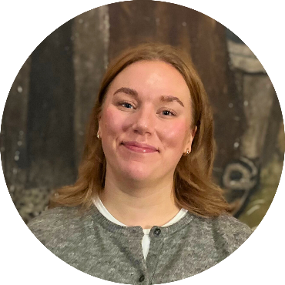
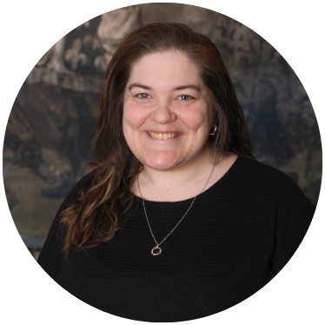
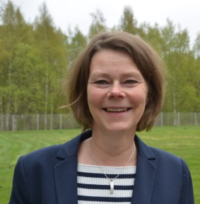
ÅA & Student Union Safety net – contact persons in case of harassments
Åbo Akademi
Coordinator Jan Kraufvelin, jan.kraufvelin@abo.fi, +358 505365886
Coordinator Anita Sundman, anita.sundman@abo.fi, +358 505489505
Kåren / Student Union
Students’ Rights Expert: Ellen Ijäs
The Service Expert in Vaasa: Amanda Ehn
E-mail: trakasseriombud@studentkaren.fi
“We are here for you”
https://abofi.sharepoint.com/sites/intra-en-study/SitePages/Support-in-cases-of-harassment.aspx
Notes:
Safety Nets for you here at ÅA.

Slide 14
Spot & dare to act scenarios?
Notes:
Discuss with your neighbour: what does safe space mean to you and what are your expectations of Finland+

Slide 15
Your class is going on a field trip to one of the islands but one in your class who is in a wheelchair cannot come because the boat that will take you from mainland is not accessible. Your professor say, “well you can never arrange so that it works for everyone anyway and there is nothing we can do about it now”.

Slide 16
One of the older female PhD students in your department always comes out to party with you, which is great because she is hilarious. She usually jokes and flirt with one of your male classmates who does not always seem comfortable with it, but he is a shy person and as the PhD woman say men are just not used to strong women who take charge and it’s just a bit of harmless flirting anyway.

Slide 17
At the end of a lesson one of the students goes up to the teacher and says with a high voice: “I think you are very nice and good looking; do you already have a boyfriend, or do you want to go out on a date with me?”

Slide 18
You are going with a friend to the student services. Your friend prefer to use the pronoun they, and not the pronoun he or she to the student services. One of the staff keeps referring to they as him every time even if they told her it is they. She explains that when she grew up men were men and women were women, and you did not use non-binary pronouns such as they.

Slide 19
A group of friends, including one person who is from the Middle East, are spending the night going from bar to bar. Each time they enter a new bar, Pelle, one of the group members, make jokes about the Middle Eastern friend's backpack making a ticking sound (insinuating that he might be a terrorist) and that hopefully the security guards in the bar won't notice. The friend who is the focus of the jokes laughs along with the group.

Slide 20
John and Patrick lives in same building in the student village. As many other times they head to a party and John has quite a lot to drink. Patrick did not have as much and have to practically carry John back to his room but realizes when they get there that John has forgotten his key. Patrick offers John to stay at his room and John agrees. Both goes to sleep in the same bed. When John wakes up he finds Patrick’s arm around him and his underwear on the floor. He cannot remember what happened. John leaves before Patrick wakes up.

Slide 21
Notes:
Consent in theory
- Consensual sex is about knowing that all the parties involved agree to have sex at the beginning and throughout. Nothing will prevent unwanted sex/sexual assault more than consent.
- What is sex? Sex means different things for different people. Consent should be given for anything considered sexual with same/different sex partners, even if the people involved are in a relationship.

